Slide 1



#codebasicsresumechallenge
TliQ Mart
FMCG Manufacturer
Gujarat, India.
Domain : Supply chain issue in FMCG
Task: Build a dashboard with key Insights

Slide 2
KPIs
OT % - On Time Delivery Percentage
IF % - In Full Delivery Percentage
OTIF % - On Time & In Full Delivery Percentage
LIFR – Line Fill Rate
VOFR – Volume Fill Rate (Quantity)
COCT – Customer Order Cycle Time

Slide 3
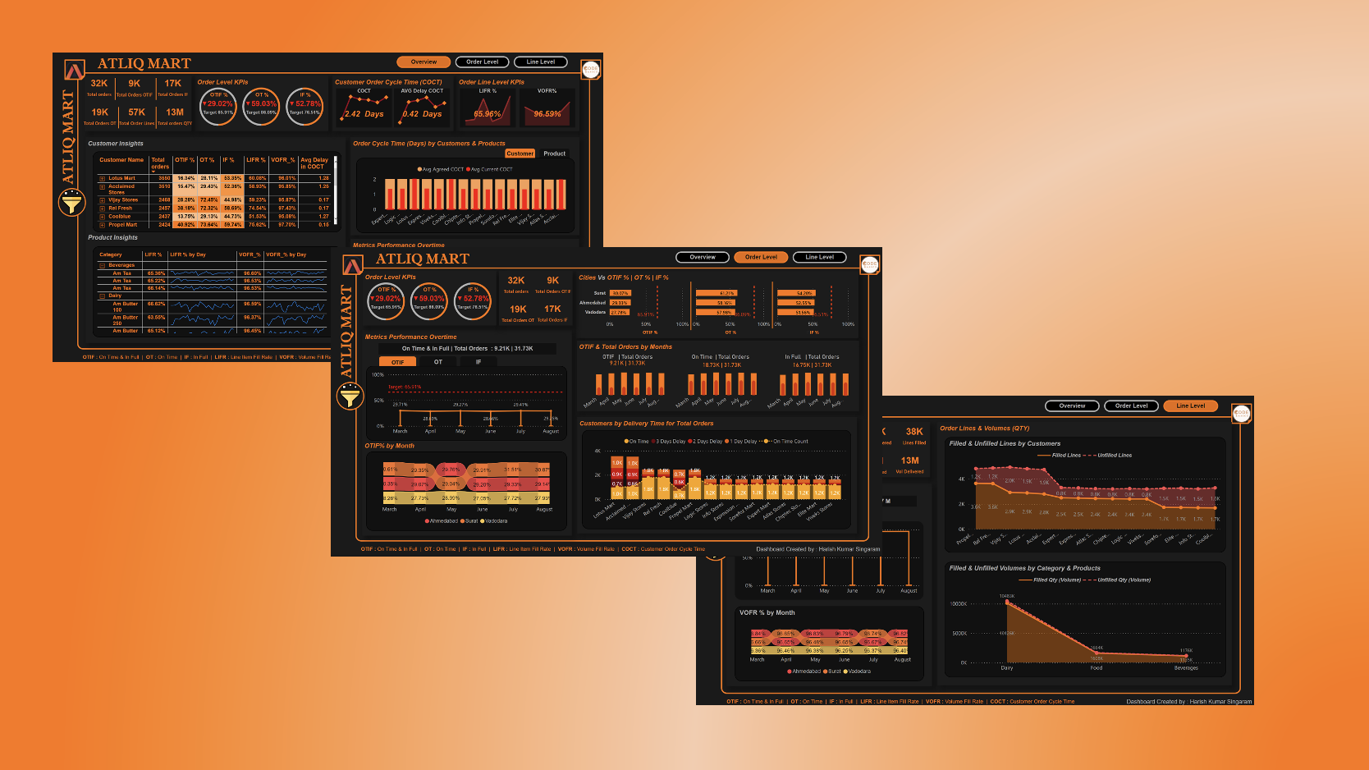
Dashboard Design

Slide 4
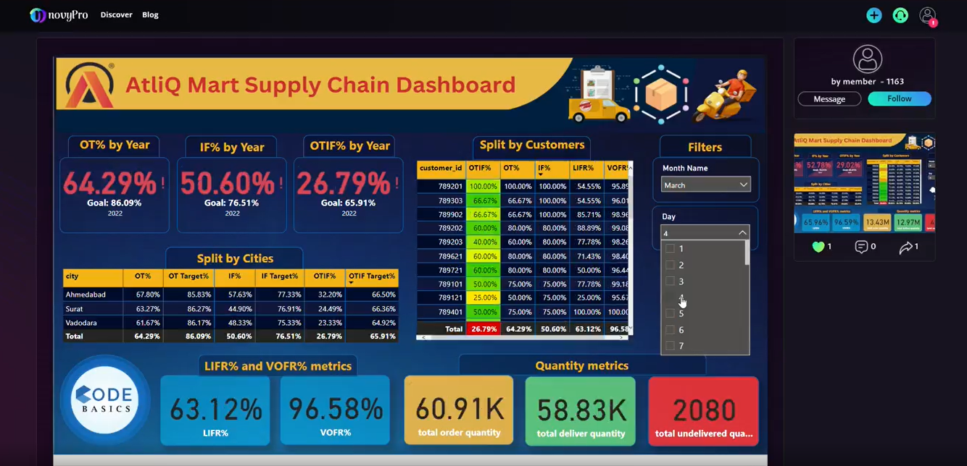
Overview

Slide 5
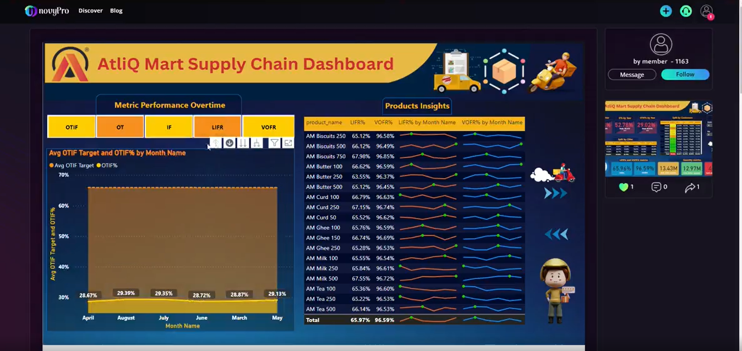
Order Level

Slide 6
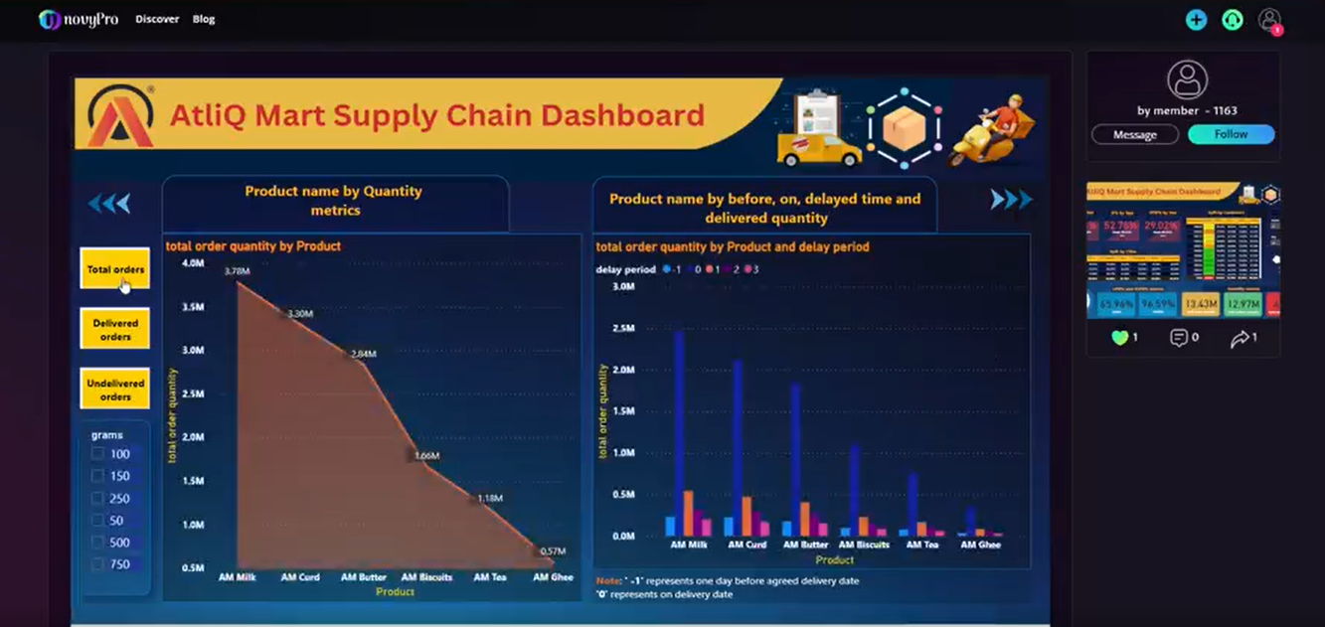
Line Level

Slide 7
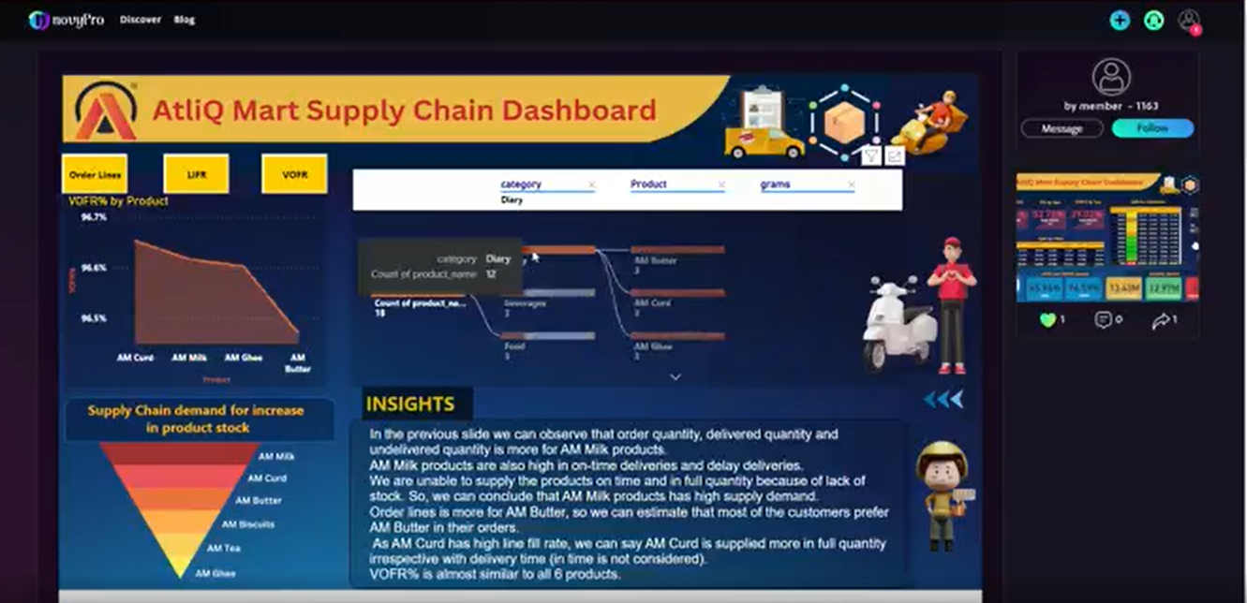
Insights:-

Slide 8
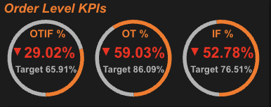
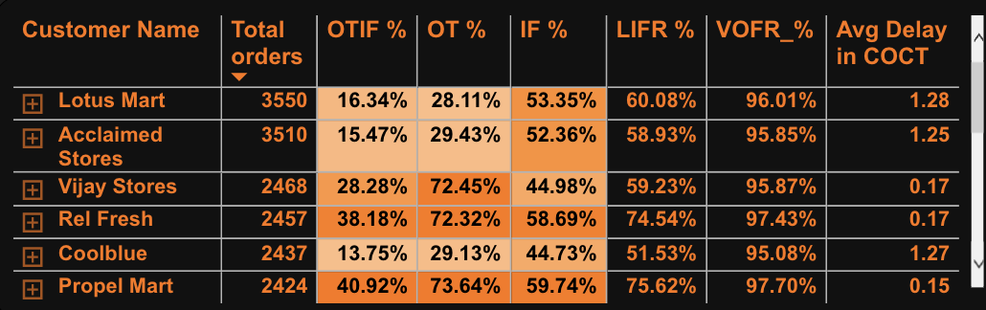
Key Findings
The On-Time Delivery % & In-Full Delivery % are about 30% behind the target % and the trend in all the months is approximately same and the On Time & In Full Delivery percentage is about 35% less than the target.
Lotus Mart has placed the highest number of orders while OTIF % is only 16.34% and Ontime delivery % is 28,11% which need to be looked upon, and the orders sent to them are 53.35% Full. The average order cycle time for the Lotus Mart is 1.28 days which is the most compared to the other customers. We have a chance of loosing this customer, Hence we need to work with a strategy to retain this customer.
Propel Mart has the least Order Cycle Time which is 0.15 days, i.e, its almost delivered the same day. This results in a happy customer service.

Slide 9
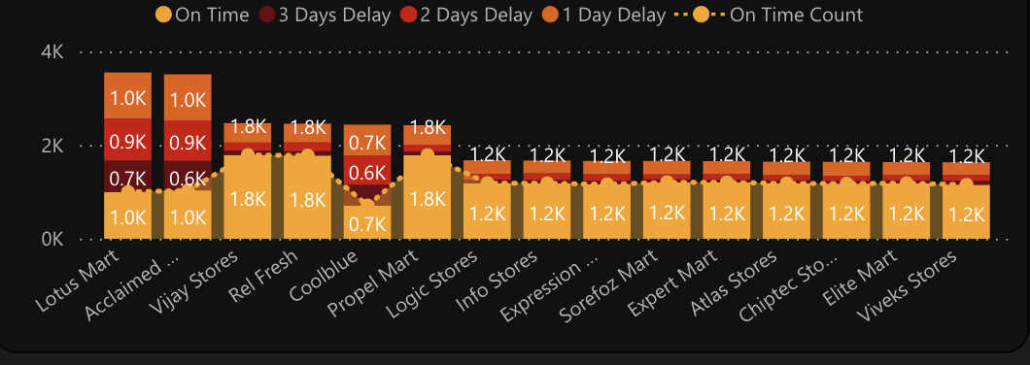
Key Findings
Diary is the most valuable product Category followed by Food and Beverages.
“AM Milk 250” is the most ordered and delivered product but still it hasn’t got much backlog compared to “AM Milk 100”.
The Line fill rate of the Coolblue, Acclaimed stores, Elite Mart, Vijay Stores, Info Stores, Lotus Mart and Sorefoz Mart Are significantly low compared to other customers.

Slide 10
Key Findings
Lotus Mart and Acclaimed stores are receiving the the deliveries late compared to all the other customers which has to be looked upon.
Ghee, curd and butter products are most delayed to deliver.
There is no Noticeable improvements in any of the KPIs in the past months.
The service should be improved in order to retain the customers.
The possible churning customer are, ” Acclaimed stores, “Lotus Mart” & Cool Blue on whom the management has to focus to improve the service to them for renewing the annual contracts.

